Slide 1
Mortality Rates by Age and Country
B.A. Brumback (2022) Fundamentals of Causal Inference page 19 and 20.

Slide 2
Mortality Rates by Age and Country
Country | Age Group | Deaths | Population | Rate*
USA | <65 | 756,340 | 282,305,227 | 0.002679
USA | 65+ | 2,152,660 | 48,262,955 | 0.044603
USA | Overall | 2,909,000 | 330,568,182 | 0.008800
China | <65 | 2,923,480 | 1,297,258,493 | 0.002254
China | 65+ | 7,517,520 | 133,015,479 | 0.056516
China | Overall | 10,441,000 | 1,430,273,973 | 0.007300
*Rate = Deaths / Population

Slide 3

Overall death rate in 2019
USA $\frac{2909000}{330568182}=0.0088$
China $\frac{10441000}{1430273973}=0.0073$
The overall death rate in the USA exeeds that of China.

Slide 4
Conditional Probability
Y = 1; being death at the end of the year.
Y = 0; being alive at the end of the year.
T = 1; USA citizan.
T = 0; Chine citizan.
H = 1; 65+
H = 0; <65

Slide 5
Conditional Probability
P(Y=1|T=1, H=0) = 0.002697
P(Y=1|T=0, H=0) = 0.002254

Slide 6
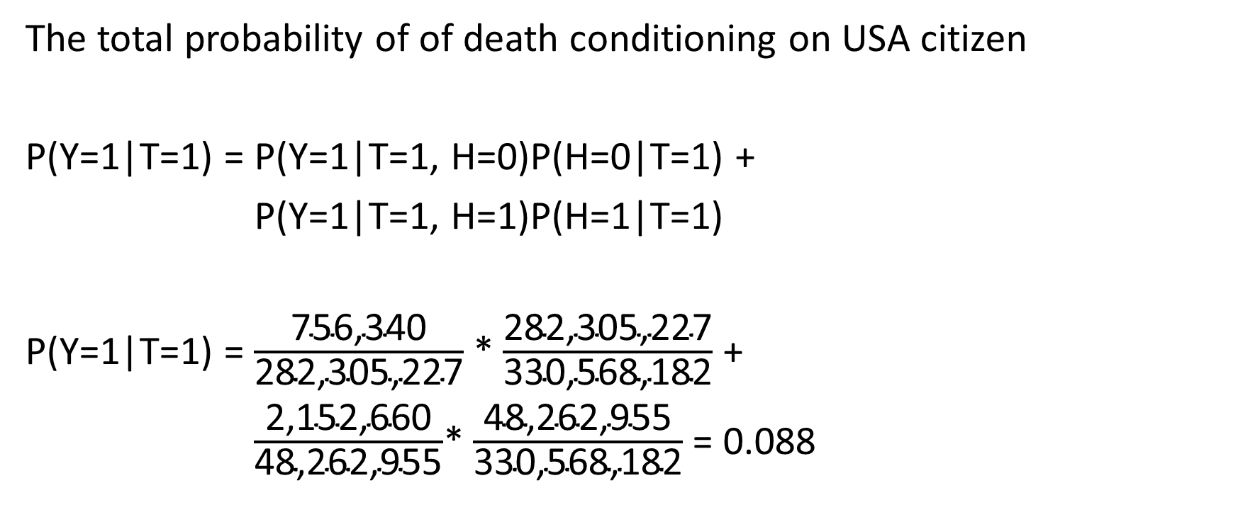
Law of total probability
The total probability of of death conditioning on USA citizen
P(Y=1|T=1) = P(Y=1|T=1, H=0)P(H=0|T=1) +
P(Y=1|T=1) = P(Y=1|T=1, H=1)P(H=1|T=1)
P(Y=1|T=1) = $\frac{\text{756,340}}{\text{282,305,227}}$ * $\frac{\text{282,305,227}}{\text{330,568,182}}$ +
P(Y=1|T=1) = $\frac{\text{2,152,660}}{\text{48,262,955}}$* $\frac{\text{48,262,955}}{\text{330,568,182}}$ = 0.088

